Slide 1
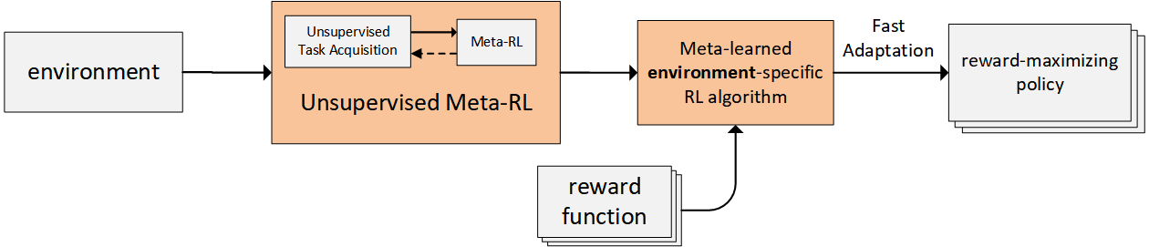
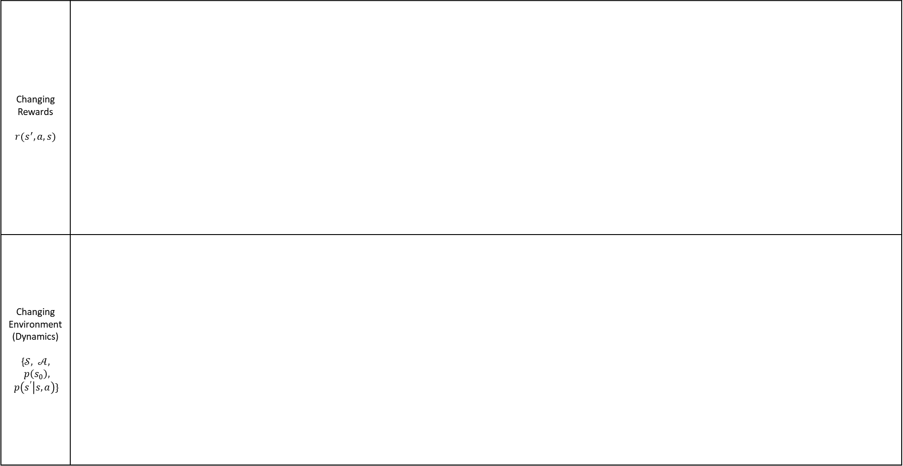
Current Landscape
Changing Rewards $$r(s^{′},a,s)$$
Changing Environment (Dynamics) {$𝒮, 𝒜, p\left(s_{0}\right), p\left(s^{′} | s,a\right)\}$
DIAYN
DADS
Model-free: MAML, etc
Unsupervised Meta-Learning for Reinforcement Learning
ADR
Model-free: MB-MPO
Model-based: GrBAL/ReBAL

Slide 2
Option 1: Task Acquisition For Changing Environment Setting
Changing Rewards $$r(s^{′},a,s)$$
Changing Environment (Dynamics) {$𝒮, 𝒜, p\left(s_{0}\right), p\left(s^{′} | s,a\right)\}$
DIAYN
DADS
Model-free: MAML, etc
Unsupervised Meta-Learning for Reinforcement Learning
Option 1a: Improve on ADR
Option 1b: New, more automated task acquisition method
Model-free: MB-MPO
Model-based: GrBAL/ReBAL
ADR
Notes:
environment-based task acquisition is much harder than reward-based task acquisition since E={S,A,p(s_0),p(s'│s,a)} whereas R = r(s',a,s), also because reward-based tasks are constrained by the environment whereas the environment is not really constrained by anything

Slide 3
Option 1: Task Acquisition For Changing Environment Setting
Changing Rewards $$r(s^{′},a,s)$$
Changing Environment (Dynamics) {$𝒮, 𝒜, p\left(s_{0}\right), p\left(s^{′} | s,a\right)\}$
DIAYN
DADS
Model-free: MAML, etc
Unsupervised Meta-Learning for Reinforcement Learning
Option 1a: Improve on ADR
Option 1b: New, more automated task acquisition method
Model-free: MB-MPO
Model-based: GrBAL/ReBAL
ADR
Option 1c: ADR
+
Meta-RL

Slide 4
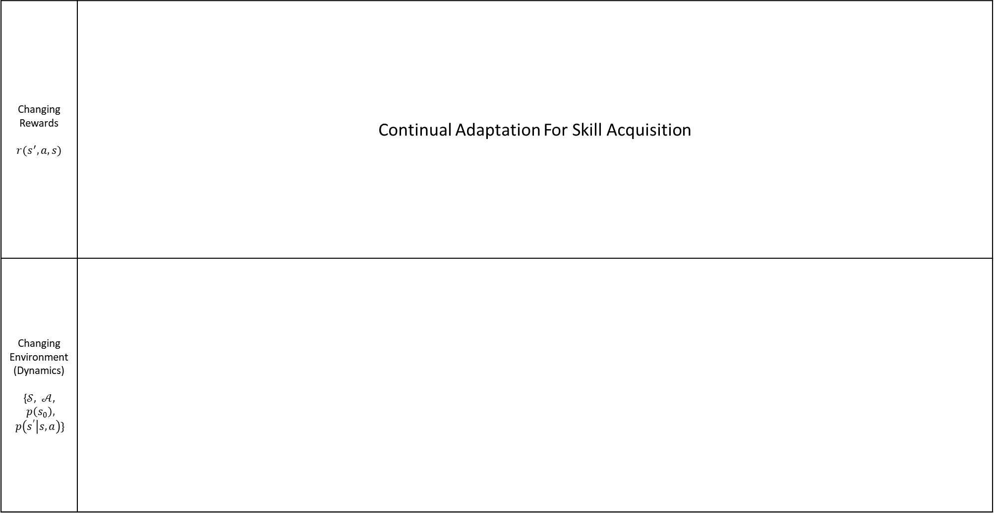
Option 2: Continual Adaptation for Skill Acquisition
Changing Rewards $$r(s^{′},a,s)$$ | Continual Adaptation For Skill Acquisition
Changing Environment (Dynamics) {$𝒮, 𝒜, p\left(s_{0}\right), p\left(s^{′} | s,a\right)\}$
Feedback signal to adjust initially uniform prior over skill space
Automated method utilizing a task variable
Meta-RL with task Acquisition Pipeline
Feedback signal to adjust initially uniform prior over skill space
(enabler for automated task acquisition [Option 1])
Notes:
* Continual learning/adaptation to update the (initially uniform) prior p(z) based on how useful/relevant each of the skills learned turned out to be to the downstream tasks (in the previous iteration, e.g. via [10]):
A- focusing on skill acquisition and training more on relevant stuff improves performance and efficiency
B- more true to real-life where the training and testing periods are interleaved and continuous rather than one relatively small training period and then testing for the rest of eternity
Continual skill adaptation Vs. Continual meta-learning:
A- Continual skill adaptation: interleaving training and testing periods is natural. Does not require storage of each encountered test task. Initial performance on new tasks is perhaps better due to the skills composed for performing on it being already used for pre-training. Meta-training on skills could be more robust then on specific tasks.
B- Online MAML: storage of all data/tasks seen so far (memory-intensive) and meta-train on it (compute-intensive) continually (maybe also not suitable for fast online adaptation). Initial performance on new tasks is probably poorer (and less efficient) than in case where pre-training has already been done on skills.
C- TAML: basically an online MAML with no need to store the each encountered test tasks but maintains a parametrized distribution over each of the meta-parameters and updating the parameters of each distribution continually (meta-params with smaller variance are more important for the knowledge accumulated so far, thus they would change slower in the future in order to preserve the learned skills). BGD is computationally expensive. Initial performance on new tasks is probably poorer (and less efficient) than in case where pre-training has already been done on skills.
D- Continual MAML: starts with priors from MAML with no need for storage of encountered tasks and applies kind of online MAML where meta-parameters are updated as necessary. Initial performance on new tasks is probably poorer (and less efficient) than in case where pre-training has already been done on skills (depending on what tasks were used to acquire the MAML prior).
E- MOLe: starts with a prior (on model-parameters) obtained from MAML then learns online a mixture of NNs each representing a dynamics model for each of the identified tasks (new tasks/models are added to the mixture as necessary, otherwise the corresponding existing model is adapted to the current task). the size of the ensemble grows over time and is unbounded, hence can become memory-consuming when there are many tasks.

